Slide 1
FAITH, BELIEVING, SEEING
23 February 2019

Slide 2
Hebrews 11:1 Now faith is the substance of things hoped for, the evidence of things not seen.
2Corinthians 4:18 While we look not at the things which are seen, but at the things which are not seen: for the things which are seen are temporal; but the things which are not seen are eternal.

Slide 3
1Cor 13:9 For we know in part, and we prophesy in part.
1Cor 13:10 But when that which is perfect is come, then that which is in part shall be done away.
1Cor 13:11 When I was a child, I spake as a child, I understood as a child, I thought as a child: but when I became a man, I put away childish things.
1Cor 13:12 For now we see through a glass, darkly; but then face to face: now I know in part; but then shall I know even as also I am known.
Ecclesiastes 3:11 He hath made every thing beautiful in his time: also he hath set the world in their heart, so that no man can find out the work that God maketh from the beginning to the end.

Slide 4


Slide 5
Isaiah 55:8-11 For my thoughts are not your thoughts, neither are your ways my ways, saith the LORD.
For as the heavens are higher than the earth, so are my ways higher than your ways, and my thoughts than your thoughts.
For as the rain cometh down, and the snow from heaven, and returneth not thither, but watereth the earth, and maketh it bring forth and bud, that it may give seed to the sower, and bread to the eater:
So shall my word be that goeth forth out of my mouth: it shall not return unto me void, but it shall accomplish that which I please, and it shall prosper in the thing whereto I sent it.

Slide 6
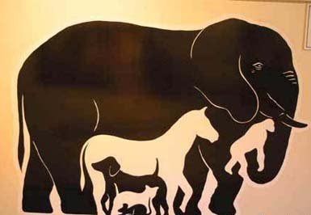

Slide 7
Jeremiah 29:11-13 For I know the thoughts that I think toward you, saith the LORD, thoughts of peace, and not of evil, to give you an expected end.
Then shall ye call upon me, and ye shall go and pray unto me, and I will hearken unto you.
And ye shall seek me, and find me, when ye shall search for me with all your heart.
Jeremiah 17:9-10 The heart is deceitful above all things, and desperately wicked: who can know it?
I the LORD search the heart, I try the reins, even to give every man according to his ways, and according to the fruit of his doings.

Slide 8
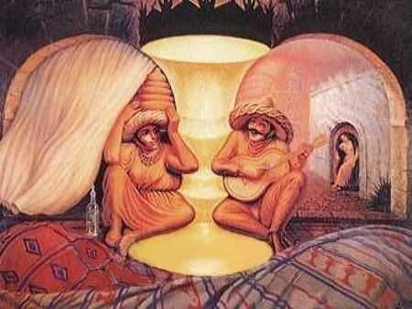

Slide 9
Romans 8:28 And we know that all things work together for good to them that love God, to them who are the called according to his purpose.
John 14:15 If ye love me, keep my commandments.
John 14:23 … If a man love me, he will keep my words: and my Father will love him, and we will come unto him, and make our abode with him.

Slide 10


Slide 11
